Slide 1
360-DEGREE WEB CONFERENCING DEVICE

Slide 2
Documentation
<number>

Slide 3
Improvement
Creation of critical decision log
Enhance communication prior to meetings
Developed better documentation practices
Utilising different hardware for the product
Shortfall
Falling behind acquisition schedule
Creation of coding log
Possible improvement surrounding documentation
Better documentation on work division
<number>
Notes:
There was one reviewer commenting that the goals set for Audit 1 has not been met, and it was difficult to determine what they meant by this. Since Audit 1 was based on scoping and defining the project.
Secondly, to explain the work break down time division, it’s an estimation in hours for how long one person will take to complete it. But when it comes to the project, a 48 hours task for 1 person can be divided between 3 or 4 people, resulting in 12 hours each.
Thirdly, there was conflicting review on the navigation of our repository, with some review mentioned it being easy to follow while other say it was difficult and required a README. This is very strange to us as the navigation should be simple from the folder title. But we have attempted to divided the folders further to improve visibility and updated the README file to contain a summary of each week.
For the requirement ranking, I’m not sure if everyone went through this process before in previous system engineering course, but a ranking can be obtained by creating a table to compared each requirement to one another. You rate it as 1 if it’s more important than what it’s being compared with and 0 vice versa. At the end, the number can be added together to obtain a score for ranking.
Another issue was someone requesting our conversation to be made public regarding the project. We want to avoid this as copy and pasting entire facebook conversation for “analysis” is not ideal, as ideas are throwing back and forth, this can be confusing for people and would look messy within the directory. Decisions are only made official through the meeting logs. Every decision we made is as a group and has been agreed upon by everyone.
There was also a comment about engaging with our mentors, we do not have any mentors outside the direct client. He has stated multiple time that he does not have much technical knowledge regarding the device and will only be able to offer comments on the prototype design and possible functionalities.

Slide 4
Video Input
<number>

Slide 5
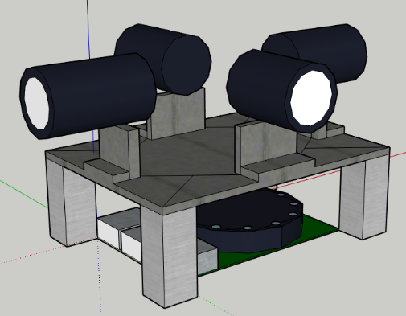
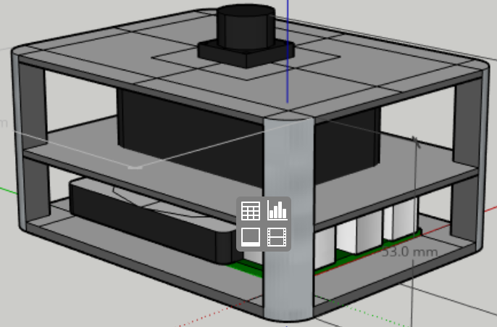
Cameras Setup
Multiple Cameras
Single Camera
4
3
<number>

Slide 6
Pros and Cons
 | Multi-cam |  | Single-cam
 | 4~5 * 90 webcam | 3~4 * 120 camera | 1 * fish-eye camera
Hardware limitation | Overflow bandwidth | Hardly fit | Leave great vacancy
Financial concerns | ~5 * 30 = 150 AUD | ~4 * 80 = 320 AUD | ~80 AUD
Challenges | Switching & Stitching |  | Unwraping & Cropping
<number>

Slide 7
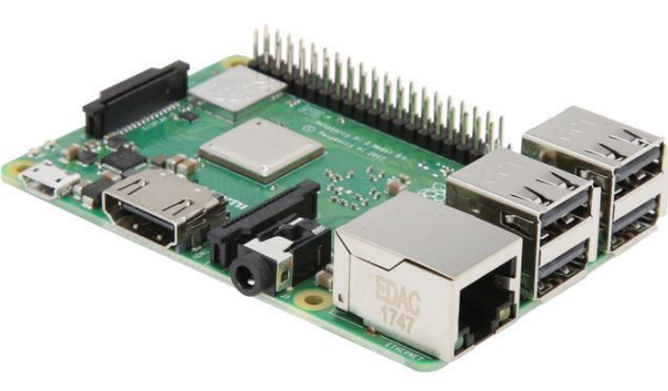
Multi-cam Limitations
Real-time dilemma
I/O limitation
Financial concerns
https://www.newegg.com/global/ec-en/Product/Product.aspx?Item=N82E16813142011
<number>

Slide 8
Multi-cam Demo
<number>
Notes:
There was one reviewer commenting that the goals set for Audit 1 has not been met, and it was difficult to determine what they meant by this. Since Audit 1 was based on scoping and defining the project.
Secondly, to explain the work break down time division, it’s an estimation in hours for how long one person will take to complete it. But when it comes to the project, a 48 hours task for 1 person can be divided between 3 or 4 people, resulting in 12 hours each.
Thirdly, there was conflicting review on the navigation of our repository, with some review mentioned it being easy to follow while other say it was difficult and required a README. This is very strange to us as the navigation should be simple from the folder title. But we have attempted to divided the folders further to improve visibility and updated the README file to contain a summary of each week.
For the requirement ranking, I’m not sure if everyone went through this process before in previous system engineering course, but a ranking can be obtained by creating a table to compared each requirement to one another. You rate it as 1 if it’s more important than what it’s being compared with and 0 vice versa. At the end, the number can be added together to obtain a score for ranking.
Another issue was someone requesting our conversation to be made public regarding the project. We want to avoid this as copy and pasting entire facebook conversation for “analysis” is not ideal, as ideas are throwing back and forth, this can be confusing for people and would look messy within the directory. Decisions are only made official through the meeting logs. Every decision we made is as a group and has been agreed upon by everyone.
There was also a comment about engaging with our mentors, we do not have any mentors outside the direct client. He has stated multiple time that he does not have much technical knowledge regarding the device and will only be able to offer comments on the prototype design and possible functionalities.

Slide 9
The saviour: Fish-eye
 | 180 degree camera | 220 degree camera
Pros | Cheaper; Easy Shipment (within 5 days) | Full coverage of the speaker’s body
Cons | Only cover upper parts of speaker’s body | Introduce dewarping problem; No straight shipment;
<number>

Slide 10
New Challenges
Fish-eye de-warping: flattening to panoramic view
Face detection
Video output and interface
<number>

Slide 11
<number>

Slide 12
Audio Processing
<number>

Slide 13
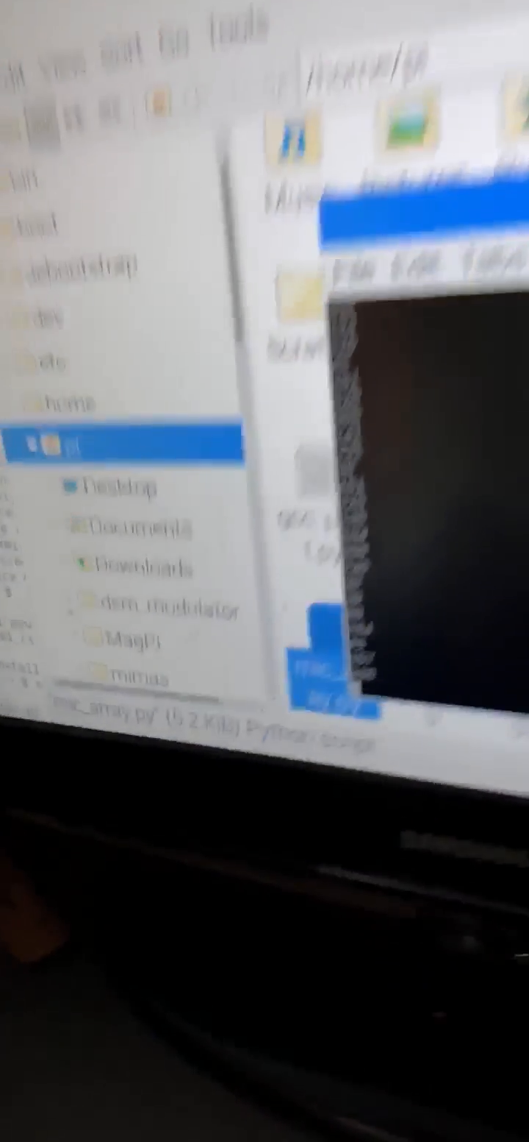
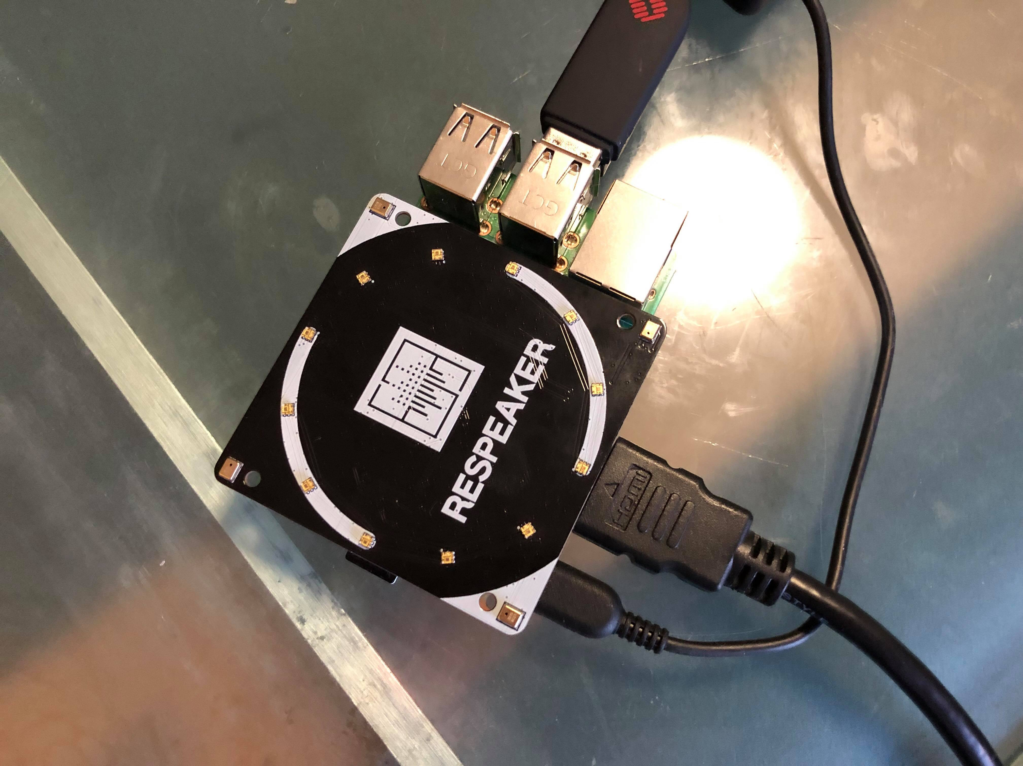
Sound Localisation
Utilising Mic Array for sound tracking
4-channels are fed to DOA algorithms for computation
The number output represents angles in degrees
Errors due to noise or sensitivity of Mic Array
<number>
Notes:
There was one reviewer commenting that the goals set for Audit 1 has not been met, and it was difficult to determine what they meant by this. Since Audit 1 was based on scoping and defining the project.
Secondly, to explain the work break down time division, it’s an estimation in hours for how long one person will take to complete it. But when it comes to the project, a 48 hours task for 1 person can be divided between 3 or 4 people, resulting in 12 hours each.
Thirdly, there was conflicting review on the navigation of our repository, with some review mentioned it being easy to follow while other say it was difficult and required a README. This is very strange to us as the navigation should be simple from the folder title. But we have attempted to divided the folders further to improve visibility and updated the README file to contain a summary of each week.
For the requirement ranking, I’m not sure if everyone went through this process before in previous system engineering course, but a ranking can be obtained by creating a table to compared each requirement to one another. You rate it as 1 if it’s more important than what it’s being compared with and 0 vice versa. At the end, the number can be added together to obtain a score for ranking.
Another issue was someone requesting our conversation to be made public regarding the project. We want to avoid this as copy and pasting entire facebook conversation for “analysis” is not ideal, as ideas are throwing back and forth, this can be confusing for people and would look messy within the directory. Decisions are only made official through the meeting logs. Every decision we made is as a group and has been agreed upon by everyone.
There was also a comment about engaging with our mentors, we do not have any mentors outside the direct client. He has stated multiple time that he does not have much technical knowledge regarding the device and will only be able to offer comments on the prototype design and possible functionalities.

Slide 14
Future Development
Stabilising the output angle
Applying Fourier Transform for thresholding
Averaging the sound input to reduce sensitivity
Utilise the array for sound capture
Noise cancellation algorithm for USB microphone
<number>

Slide 15

Thank you!
<number>

Slide 16
Questions?
<number>

